Slide 1

Trust and Protection in the
Illinois Browser Operating System
Authors: Shuo Tang, Haohui Mai, and Samuel T. King
Notes:
seminar:
1. http://www.youtube.com/watch?v=o39Lw-ALDtA
reference slides:
1. https://docs.googl,e.com/viewer?url=https%3A%2F%2Fwiki.engr.illinois.edu%2Fdownload%2Fattachments%2F119537746%2Fcs523_websec2.pdf%3Fversion%3D1%26modificationDate%3D1298492645000
pros cons questions:
https://docs.google.com/viewer?url=http%3A%2F%2Fwww.cse.unsw.edu.au%2F~cs9242%2F10%2Fexam%2Fpaper2-rev.pdf
IBOS papers:
https://docs.google.com/viewer?url=http%3A%2F%2Fwww.cs.illinois.edu%2Fhomes%2Fkingst%2Fsasse12.pdf
OPweb browser
http://www.cs.uiuc.edu/homes/kingst/Home.html

Slide 2
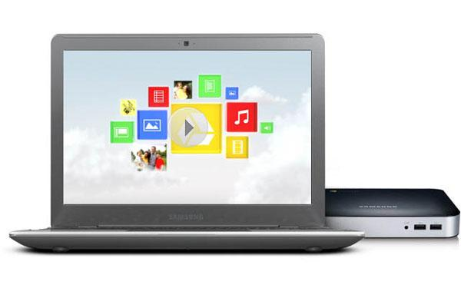
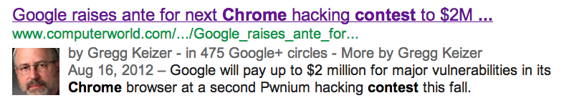
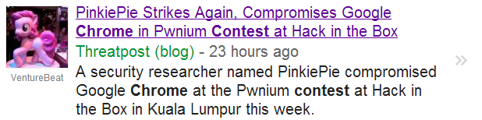
Why Browser Operating Systems?
The web is ubiquitous and has been evolved
Notes:
So the question is , why we need a browser operating system?
A browser was only used for viewing static data before. But now it transformed to view web-based applications. We use it to edit google docs, to play facebook games, and to chat with friends. Most of what we do takes place in a web browser. //So there comes ChromeOS. But, is your browser secure?
The convenience of web-based applications also raise the complexity of browsers and make browsers be popular targets for attackers. The news below says Google raises ante for the second chrome hacking contest to 2 million dollars.
//which indicates the security of a browser is really a critical issue.
The contest took place yesterday and the winner was the same as last year
PinkiePie used several discrete bugs in order to get to a point where he could impersonate the Chrome extensions manager. After that, he focused on finding a way to break out of the browser's sandbox.
"Once he was impersonating the extensions manager, Pinkie used two more bugs to finally break out of the sandbox. The first bug (117715) allowed him to specify a load path for an extension from the extension manager’s renderer, something only the browser should be allowed to do. The second bug (117736) was a failure to prompt for confirmation prior to installing an unpacked NPAPI plug-in extension. With these two bugs Pinkie was able to install and run his own NPAPI plug-in that executed outside the sandbox at full user privilege," Google said.

Slide 3
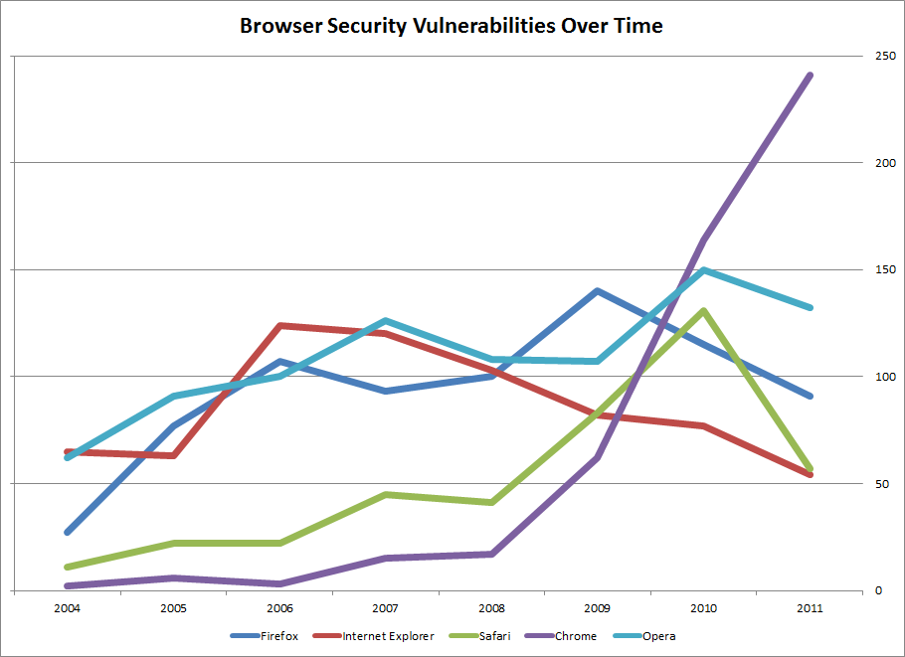





Attacks at Different Layers
According to National Vulnerability Database (http://web.nvd.nist.gov/)
Damage the web app
Get access to browser data
Control the system
Web apps
Web browsers
Operating systems
ref:http://blog.jerrynixon.com/2011/10/browser-security-vulnerabilities.html
Notes:
This figure shows the number of vulnerabilities of each browsers from National Vulnerability Database. It calculates the vulnerabilities been reported. so we can't tell if the vulnerability has been solved or not. And surprisingly the Chrome is the worst and the IE is the best in 2011. Any comments?
The more users you have, the more popular attack target you will be.
The attack at different layers has different consequence
Attack at the topmost layer, the web apps, for example script injection into a web app, will only damage the web app.
Attack at web browsers, which is more difficult, the attacker may get access to browser data and other system resources.
Attack at the lowest layer of operating systems are the most serious attack, the attacker can access arbitrary states and control the system.
The lower layer the attack take place, the larger the damage is.
cross-site scripting

Slide 4
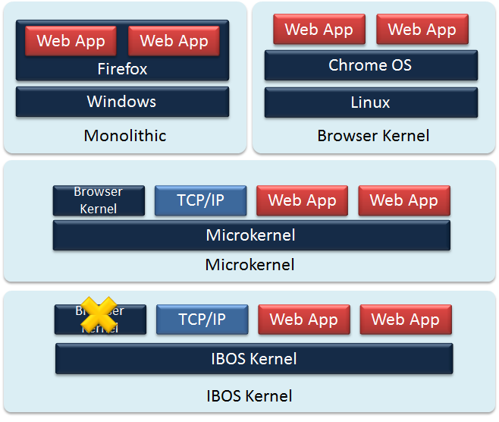

TCB in Different Architectures
Notes:
The trusted computing base (TCB) is the set of components that are critical to security,
If bugs or vulnerabilities occurring inside the TCB. they might jeopardize the entire system.
The dark blue in this figure represents the TCB.
we can see that in the monolithic system, the components are all in one address space, so if the Web App has been attacked, the whole system is in danger.
therefore in the browser kernel, they move web app out of TCB. However, the TCB is still huge.
To reduce TCB, some came up with the idea to use Microkernel,
however, above the microkernel all the components are shared so you have to trust all the components. for example if a web app open a socket to the TCP/IP. and If the TCP/IP has been broken into, all the applications communicate with the TCP/IP are vulnerable.
Therefore, IBOS kernel proposed to move the browser-level abstraction to the first class OS abstractions, and separate the browser functionality and browser security.

Slide 5
Design Principles
Make security decisions at the lowest layer of software
Use controlled sharing between web apps and traditional apps
Maintain compatibility with current browser security policies
Expose enough browser states and events to enable new browser security policies
Avoid OS sandboxing for browser components
Notes:
Here's the design principles of IBOS
Make security decisions at the lowest layer,
using a narrow interface to prevent misuse of sharing between web apps and traditional apps
improve the security without changing current web-based applications
make the architecture easy to adapt for future browser
Avoid sandboxing since it makes the system complex and difficult to implement correctly
Any drawbacks with these principles?
for example, Should web browsers support backwards compatibility over security?

Slide 6
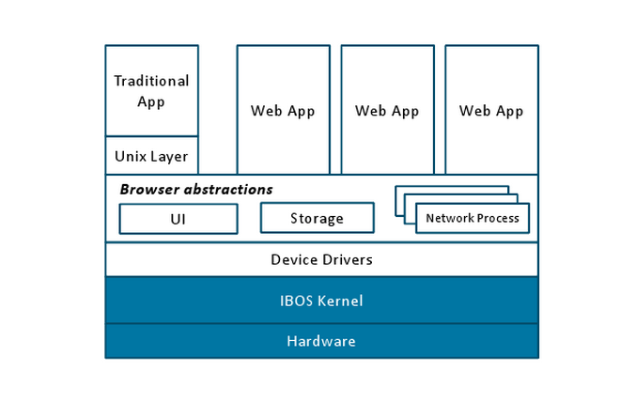
IBOS Architecture
Plugins are treated as traditional APP. Does it make sense?
Notes:
This figure is the architecture of IBOS, the blue part is its trust computing base.
The IBOS kernel is based on microkernel approach. so we can see that the device drivers are running out of the kernel.
And the browser abstractions manage the HTTP requests, local storage, and displaying UI.
It also supports traditional APP, by adding a Unix Layer on top of the browser abstraction.
Plugins are treated as traditional APP. It access browser states though standard plugin programming interface. Does it make sense to you? It seems like the performance is decreased and the security is not improved in this case.

Slide 7
Isolation by Labels
Traditional processes
Web page instances
Traditional Process
Localhost
Network Process
Google
Network Process
Ads
Web Page Instance
Google
Network Process
Ads
Web Page Instance
UIUC
Network Process
UIUC
Notes:
IBOS uses labels to specify the resources a process can access.
Labels are inferred by kernel. The label of traditional process is local host. and the label of web page instances are extract from the URL. When the web page is loading, it will make some network requests. The label of them is depends on where the requests are made to. IBOS uses this way to separate the network process and could give them different policies.

Slide 8
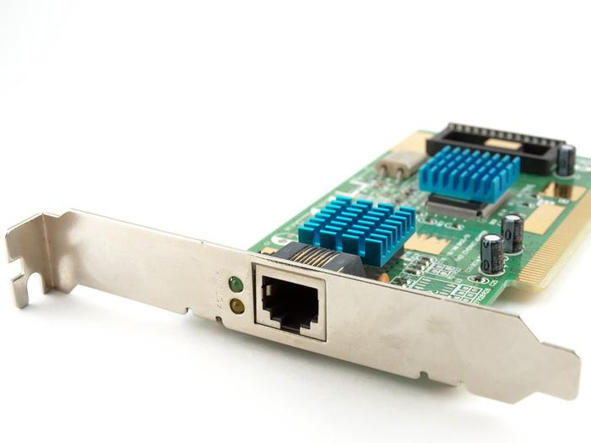
Split Driver Architecture
Network Process
illinois.edu
NIC Driver
Check TCP port
Check IP Addr
DMA Addr
Ethernet Frames
Set Tx Buffer
Validate Tx Buffer
NIC Verification Logic
IBOS Kernel
DMA Buffer

Slide 9
Security Invariants
Applied to network stacks
Applied to Drivers
Applied to UI
Page protection for display isolation
Applied to storage
Basic key-value pair object store
IBOS kernel encrypts data before storing it
Discussion - Do the security properties of the browser result in any limitations on functionality?

Slide 10
Trusted Computing Base
System | LOC
IBOS IBOS Kernel L4Ka::Pistachio | 42,044 8,905 33,139
Firefox on Linux Firefox 3.5 GTX+ 2.18 glibc 2.11 X.Org 7.5 Linux Kernel 2.6.31 | > 5,684,639 2,171,267 489,502 740,314 653,276 1,630,280
Chrome OS Chrome browser kernel 4.1.249 GTK+ 2.18 glibc 2.11 Chrome OS kernel & services (May 2010) | > 4,407,066 714,348 489,502 740,314 2,462,902
Discussion:
Is lines of code a good metric?
Notes:
Now, one way to look at their work is to see it as an experiment as to how small we can make the TCB.
They compared IBOS to Firefox on linux and the other is Chrome OS where a modified linux kernel is running Chrome web browser.
LOC is not a security metric, rough approximation of complexity, may be meaningful in orders of magnitude. Is 2000 greater than 4000 may be ... may be not. Is 40,000 better than 4 millinon ... probably yes.

Slide 11
OS and Library Vulnerabilities
Affected Component | Num. | Prevented
Linux Kernel Overall File System Network Stack Other | 21 12 5 4 | 20 ( 95% ) 12 ( 100% ) 5 ( 100% ) 3 ( 75% )
X Server | 2 | 2 ( 100% )
GTK+ & glibc | 5 | 5 ( 100% )
Overall | 28 | 27 ( 96% )
Number of vulnerabilities that IBOS prevents
Notes:
If device driver is compromised and does not count the frames correctly, it would not be detected by IBOS as verification depends on that.

Slide 12

Browser Vulnerabilities
 |  | Chrome | IBOS
Category | Num. | Contained | Contained or Eliminated
Memory Exploitation | 82 | 71 ( 86% ) | 79 ( 96% )
XSS | 14 | 12 ( 87% ) | 14 ( 100% )
SOP circumvention | 21 | 0 ( 0% ) | 21 ( 100% )
Sandbox bypassing | 12 | 0 ( 0% ) | 12 ( 100% )
Interface spoofing | 6 | 0 ( 0% ) | 6 ( 100% )
UI design flaw | 17 | 0 ( 0% ) | 0 ( 0% )
Misc | 22 | 0 ( 0% ) | 3 ( 14% )
Overall | 175 | 83 ( 46% ) | 135 ( 77% )
Rajashekhar Arasanal
The SOP relies on same domain name and IP. What if an attacker uses IP spoofing or name spoofing and sends arbitrary data to the browser?
Notes:
IBOS handles sandboxing bypass

Slide 13
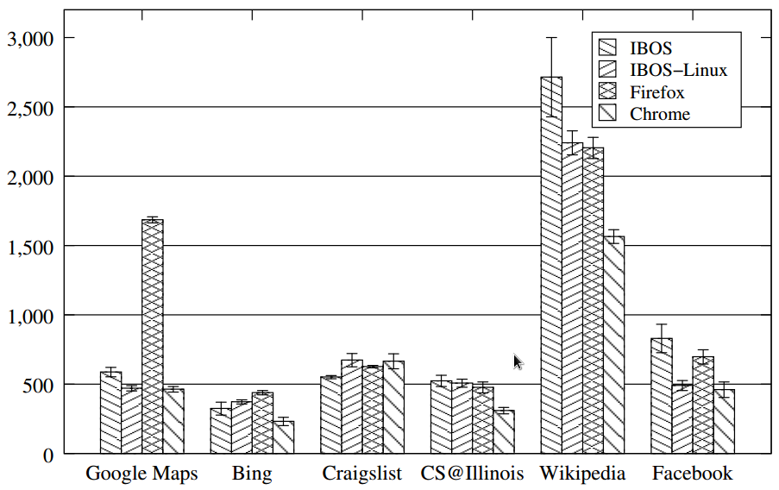
Performance
Page Load Latencies for IBOS and other web browsers. All latencies shown in milliseconds

Slide 14



Discussion
Aamer Charania
How does this compare with sand boxing?
Fred Douglas
Why not just run your web browser in a secure VM?
Matt Sinclair
Could IBOS benefit from any hardware support?

Slide 15
Conclusions
Browser abstractions as first-class OS abstractions
Trust: Reduce TCB for web browser
Protection: withstand attack to most components

